Slide 1
Flexibility: Boom in progress
Malte Schwoon, Statkraft

Slide 2
Malte 1998

Slide 3
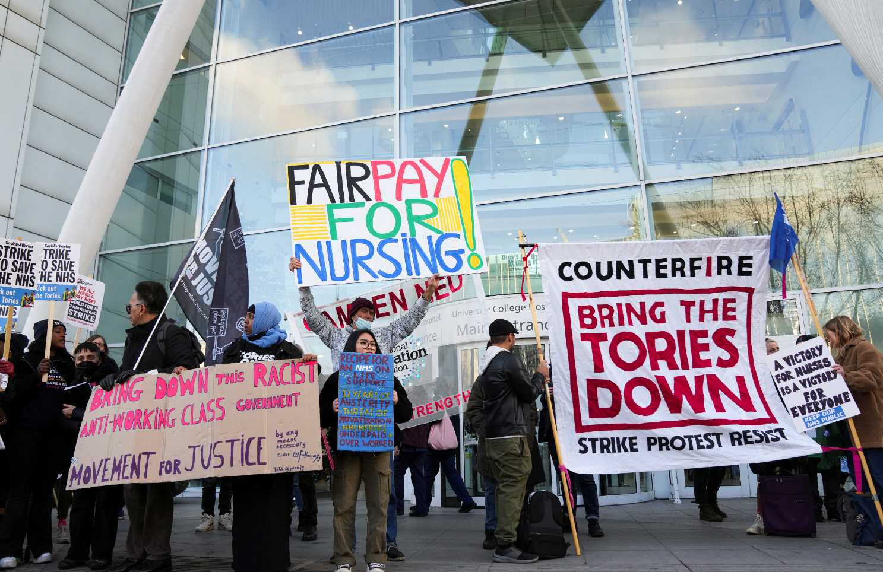
Source: https://www.cbc.ca/news/
Source: https://www.iwkoeln.de/brexit.html
Source: www.reuters.com

Slide 4
THE
ISLAND
FROM
Good
NEWS

Slide 5
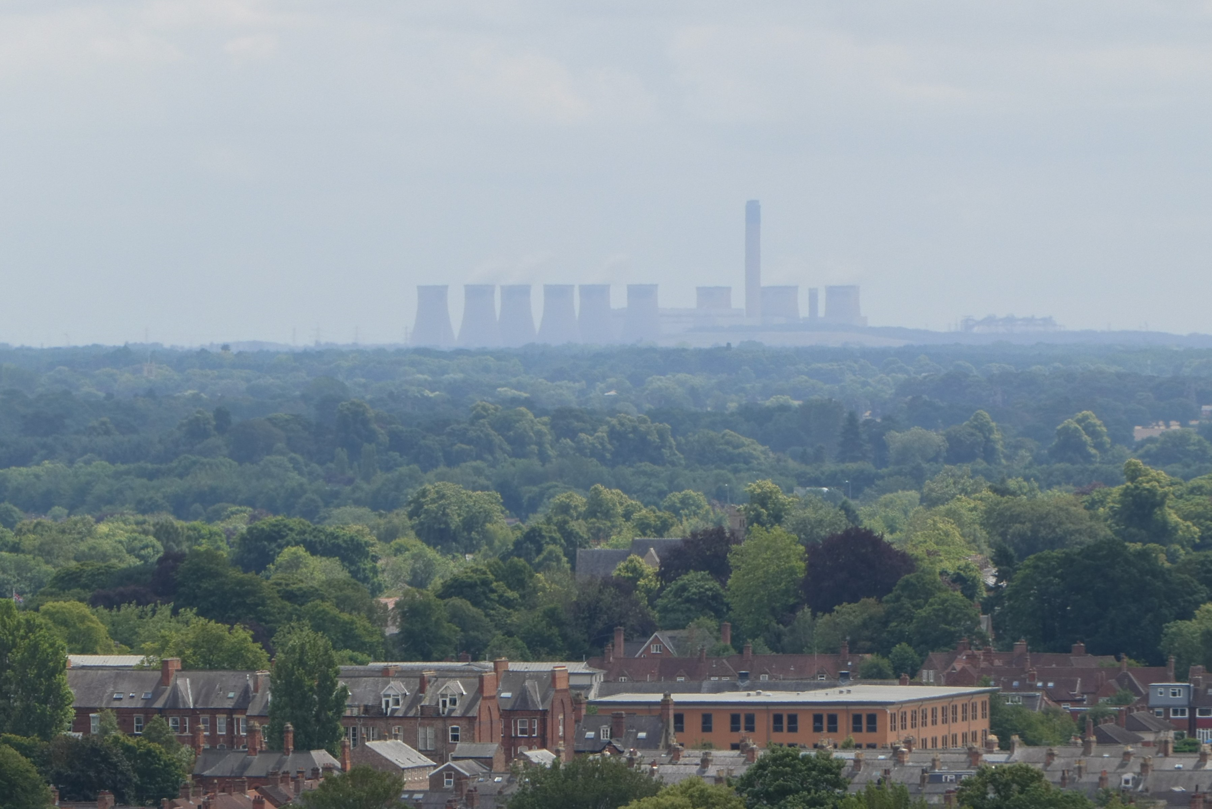
Successful coal phase out
Ratcliffe-on-Soar Power Station

Slide 6
Successful coal phase out
Source: DUKES Digest of UK Energy Statistics, www.gov.uk
Notes:
Ratcliffe-on-Soar power station

Slide 7
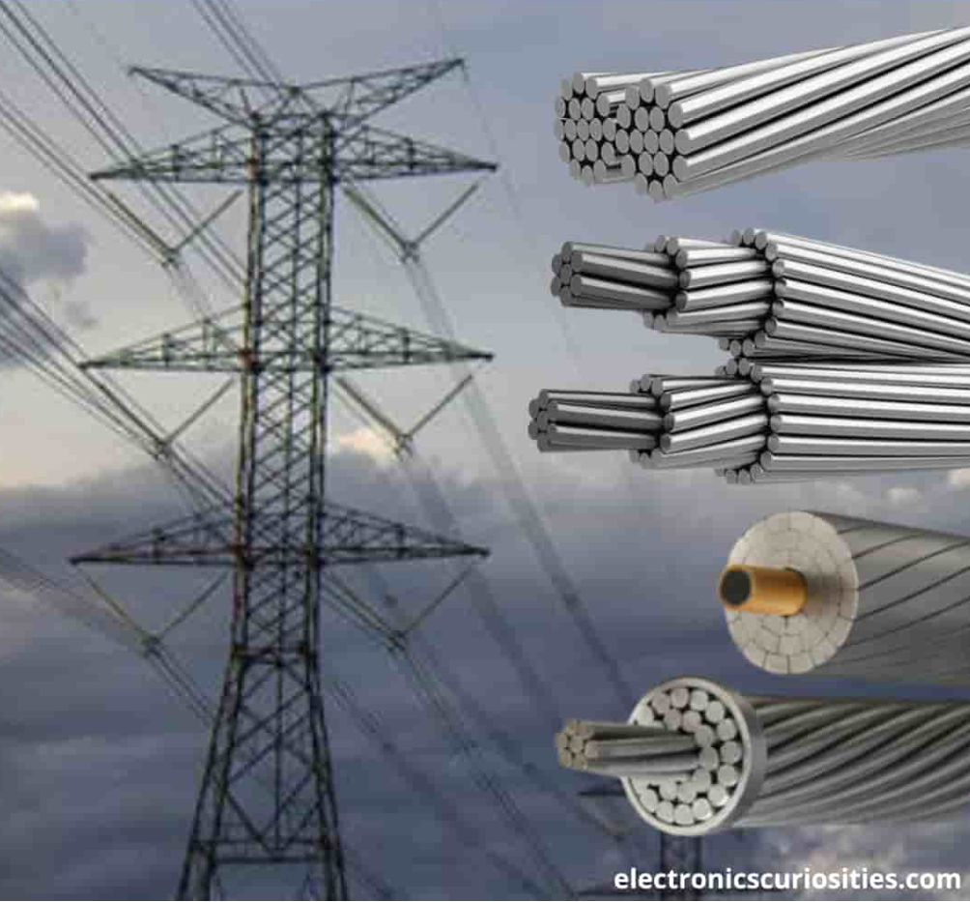
What’s the starting point?
= 3x
~10 GW of interconnection
~10 GW of interconnection

Slide 8
Share of renewable generation
Sources: DUKES Digest of UK Energy Statistics, www.gov.uk; https://opendata.cbs.nl/statline/#/CBS/en/

Slide 9
Installed renewable capacity
Sources: DUKES Digest of UK Energy Statistics, www.gov.uk; https://opendata.cbs.nl/statline/#/CBS/en/

Slide 10
Utility Scale Batteries (Built Capacity)
22 GW installed capacity
2.6GW/4.3GWh under construction
2023/2024
2027
https://www.energy-storage.news/800mwh-of-utility-scale-energy-storage-capacity-added-in-the-uk-during-2022/

Slide 11
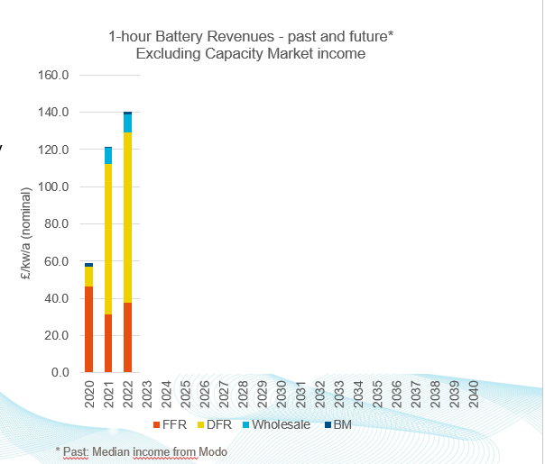
UK Battery market – what’s been driving it?
Fuelled by a Capacity Market and generous Frequency Response Service payments
Existing Frequency Response services have been replaced with new “Dynamic” Frequency Response (DFR) tailored to batteries
The DFR market is saturating this year, leading to significantly lower capacity prices
Simultaneously, National Grid is improving their dispatch of batteries in the Balancing Mechanism (BM)
Batteries expected to provide larger share of balancing energy in the future
* Past: Median income from Modo

Slide 12
What is Statkraft’s role in this?

Slide 13
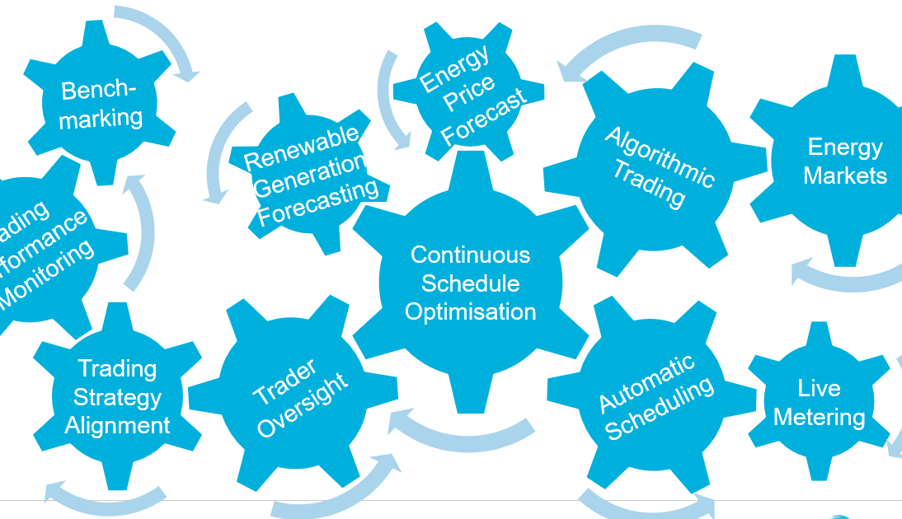
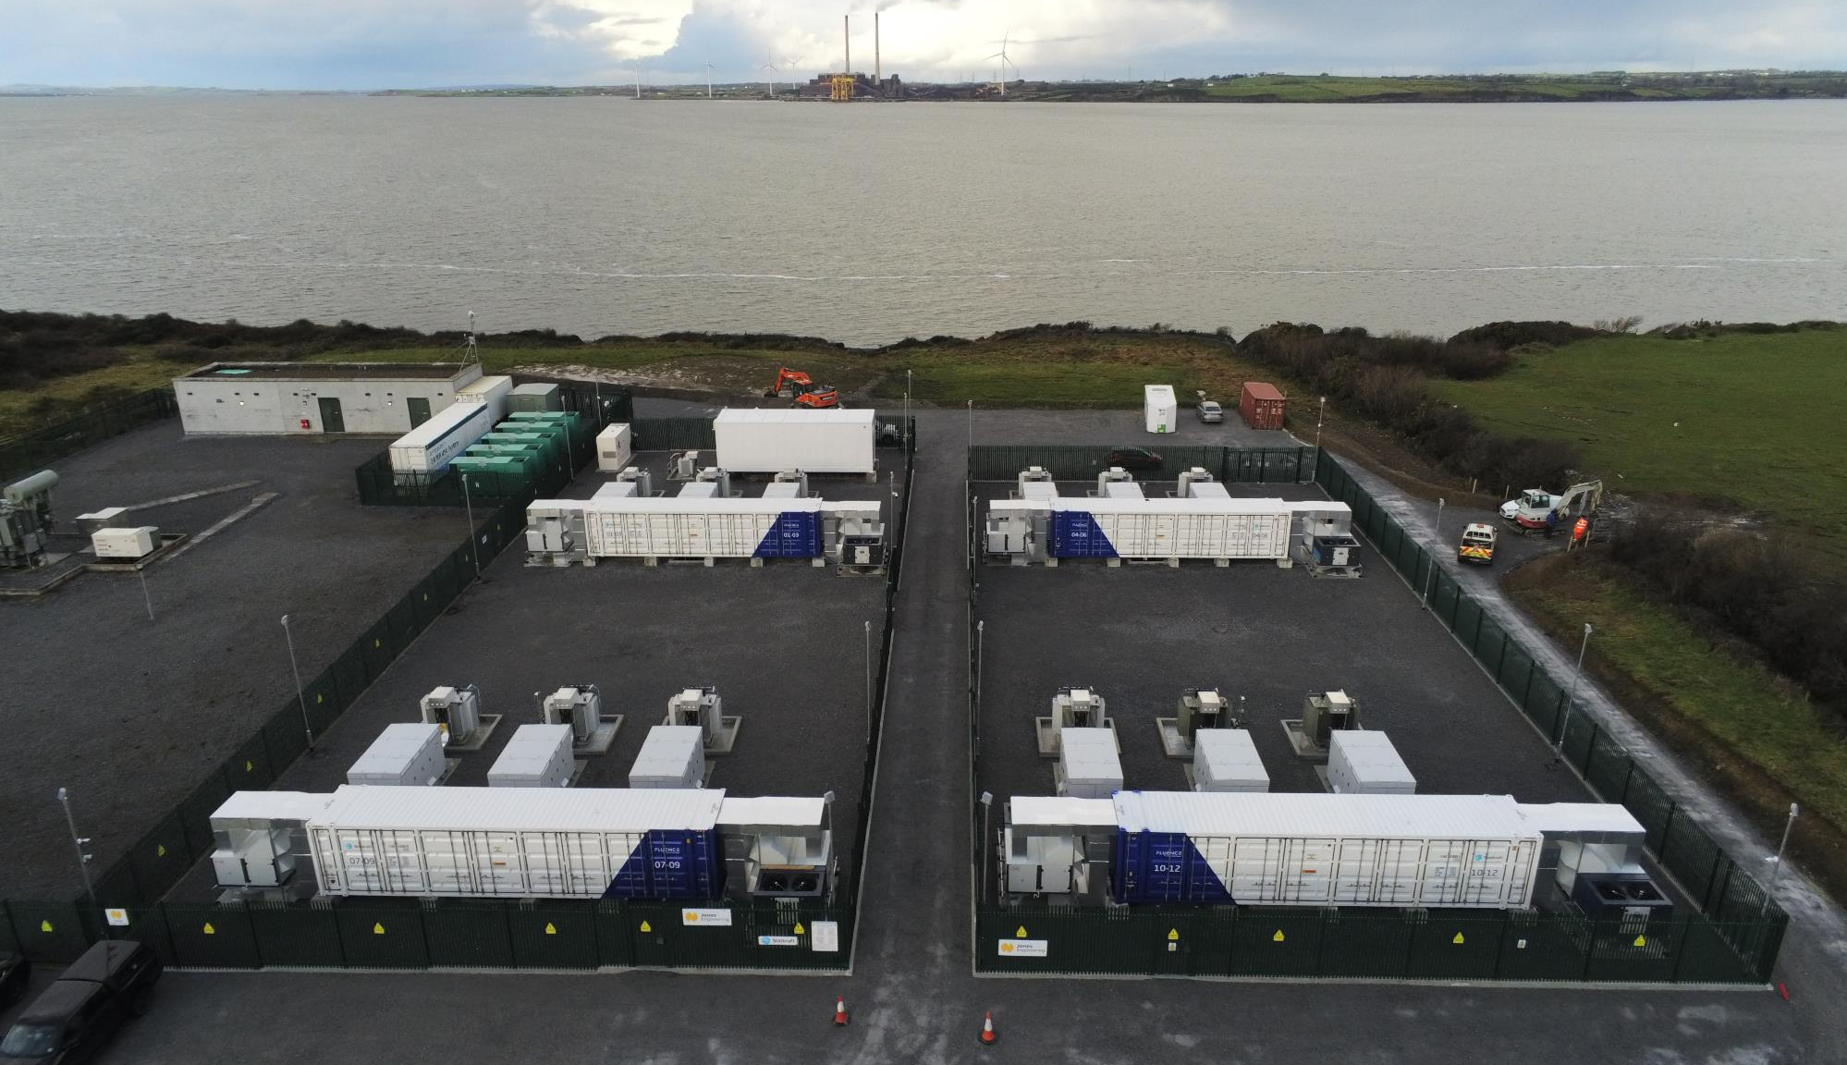
Flexibility Optimisation
#1 energy management service provider
Optimising flexibility from batteries, gas engines and will do hydrogen electrolysis
1700 MW under contract
Portfolio built in under 4 years
Revenue stacking in Ancillary Services, wholesale market optimisation, capacity market and TSO/DSO support
Trade allocation to individual assets

Slide 14
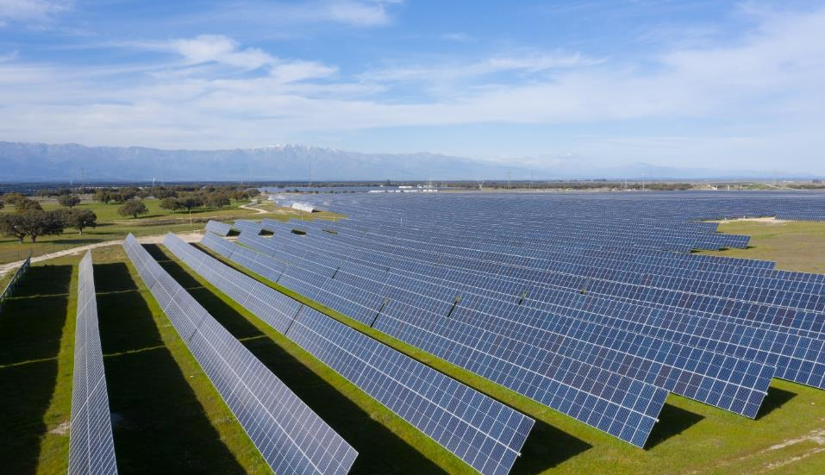
Flex optimization as part of a bigger portfolio
#1 UK market leader in long term PPAs for wind, solar and biomass
4,300MW, 12.5TWh per year of renewable power
240 long term contracts up to 20 years
Long term fixes and floors to help raise customer's finance
Unity platform optimises against wholesale price and balancing market

Slide 15
This is where the magic happens…
Image: Warner Bros.

Slide 16
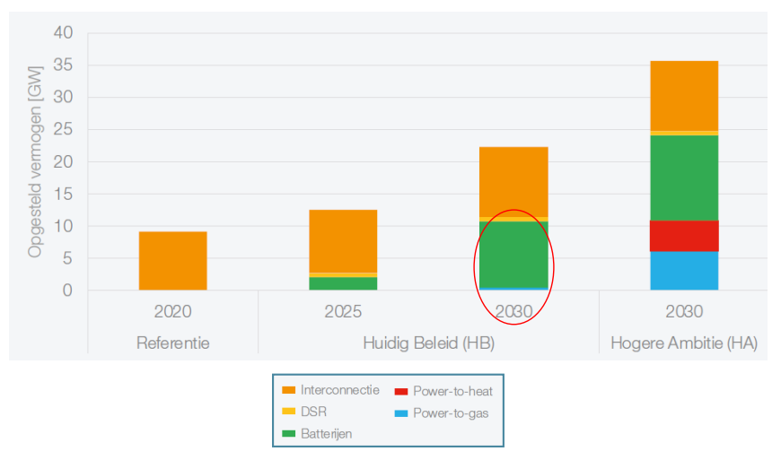
TenneT: 9 GW of Batteries in 2030 needed for grid stability
Source: https://tennet-drupal.s3.eu-central-1.amazonaws.com/default/2023-06/TenneT_s_position_large_BESS_-_Public_Info_-_update.pdf

Slide 17
The pipeline is much bigger than 9 GW
Phase 1; information pack requested #131 in total 37.5GW
Phase 2; basic design quote requested #61 in total 18GW
Phase 3; basic design quote signed #15 in total 6.5GW
Phase 4; realisation quote requested #0 n/a
Phase 5; connection in realisation #0 n/a
Phase 6; connection in-service #0 n/a
Overview of current connection requests to TenneT grid (110, 150, 220, 380kV), numbers dated from June 7th, 2023
Source: https://tennet-drupal.s3.eu-central-1.amazonaws.com/default/2023-06/TenneT_s_position_large_BESS_-_Public_Info_-_update.pdf

Slide 18
The endgame: Carbon neutral long term flex

Slide 19
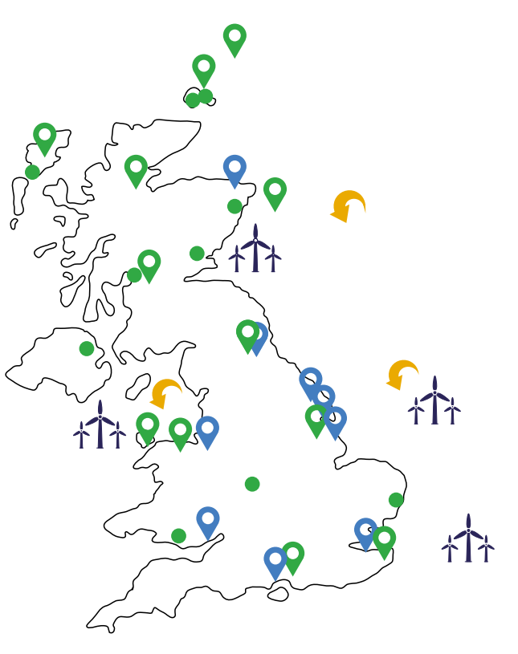
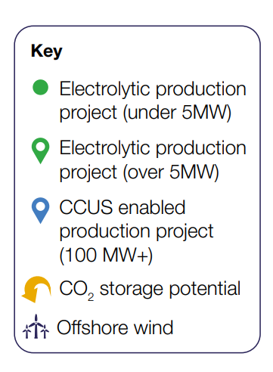
5 GW of “low carbon hydrogen” by 2030
Source: UK Hydrogen Strategy by the Secretary of State for Business, Energy & Industrial Strategy 2021

Slide 20
3-4 GW electrolysis capacity by 2030
Doubled by 2032

Slide 21
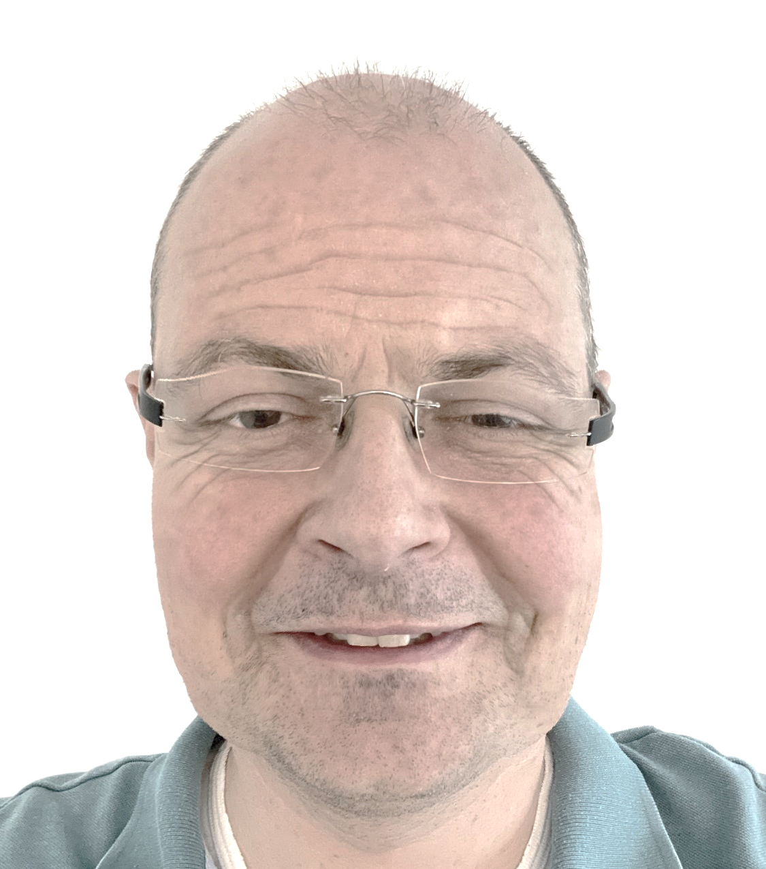
Malte 2048

Slide 22
Thank you!

